Slide 1
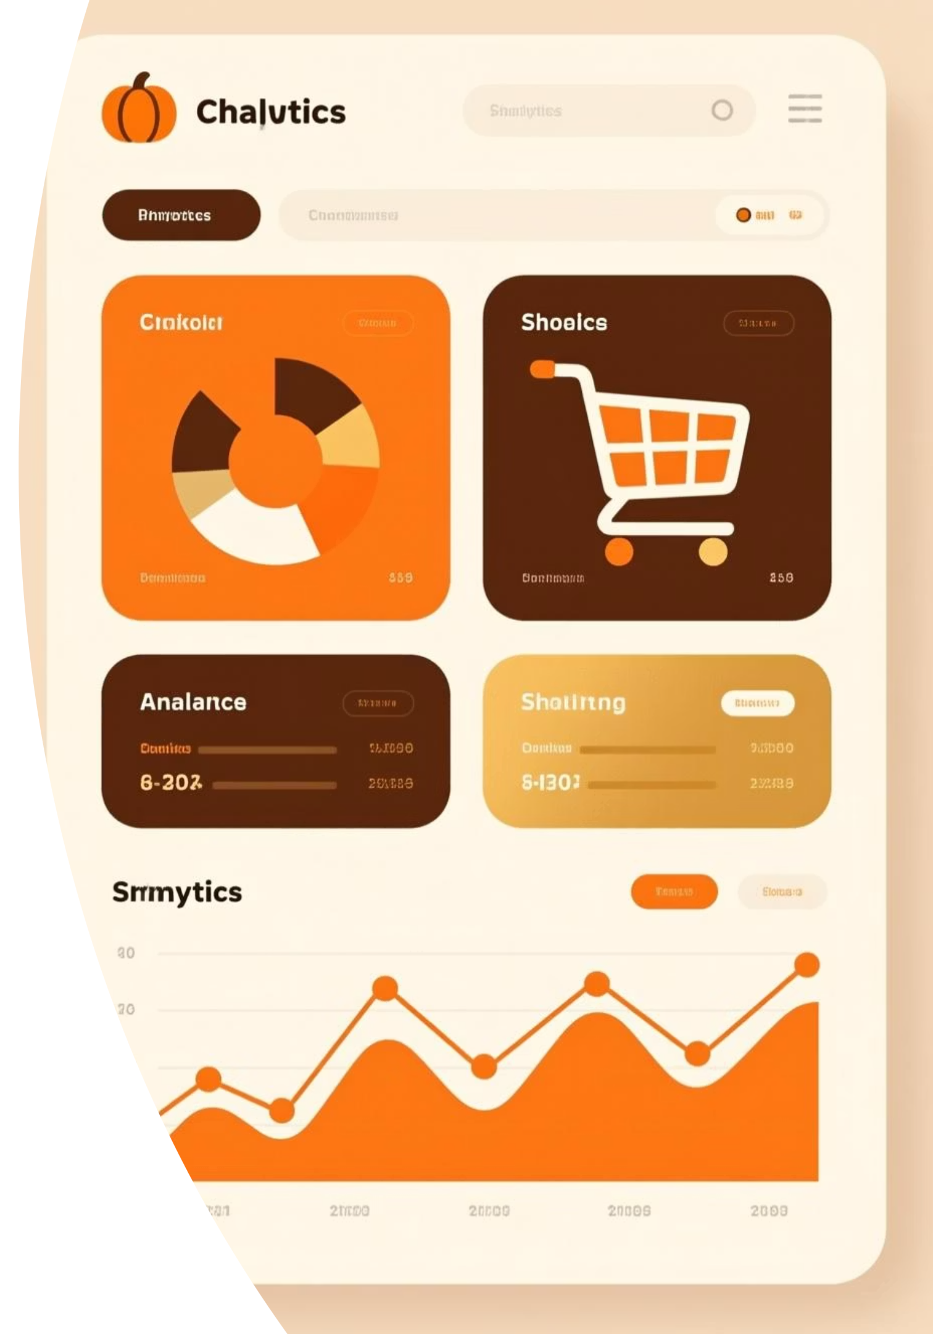
Customer Shopping Behavior Analysis
Analyzing 3,900 purchases to uncover insights into spending patterns, customer segments, and product preferences that drive strategic business decisions.

Slide 2

Dataset Overview
Scale
Demographics
3,900 transactions across 18 data columns
Age, gender, location, and subscription status tracked
Purchase Data
Behavior Metrics
Item details, category, amount, season, size, and color
Discounts, promo codes, purchase history, ratings, and shipping

Slide 3
Data Preparation Process
01
02
Data Loading & Exploration
Missing Data Handling
Imported dataset using pandas, analyzed structure with df.info() and summary statistics
Imputed 37 missing Review Rating values using median rating per product category
03
04
Feature Engineering
Database Integration
Created age_group bins and purchase_frequency_days columns for deeper analysis
Connected to PostgreSQL and loaded cleaned data for SQL analysis

Slide 4
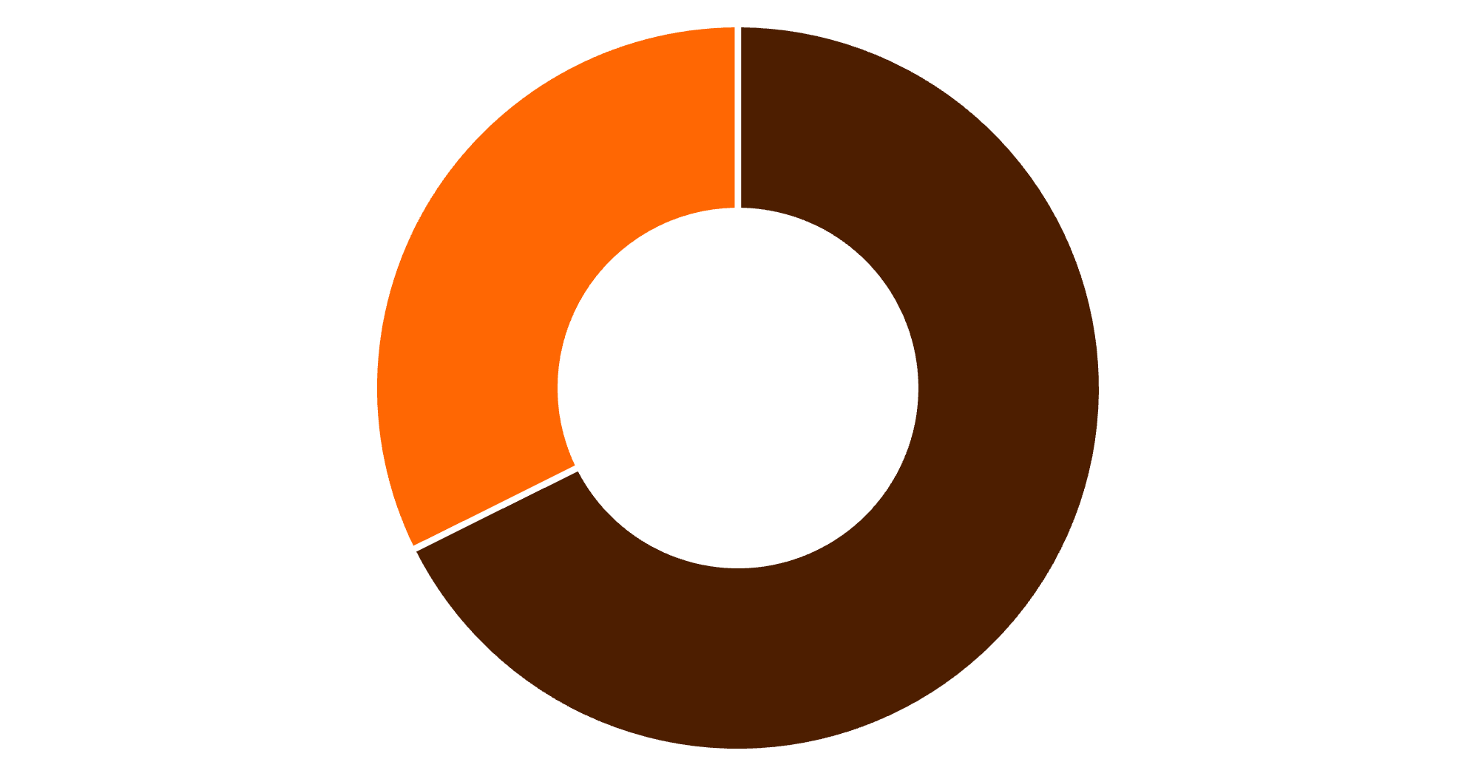
Revenue by Gender
Key Finding
Male customers generate 68% of total revenue, contributing $157,890 compared to $75,191 from female customers.
This significant disparity suggests opportunities for targeted marketing to female segments.
Male
Female

Slide 5

Customer Segmentation Insights
3,116
701
83
Loyal Customers
Returning Buyers
New Customers
The majority segment driving repeat business
Mid-tier customers with growth potential
Fresh acquisitions requiring nurturing
Customer classification based on purchase history reveals a strong loyal base, with opportunities to convert returning buyers into loyal advocates.

Slide 6
Top-Rated Products
1
2
3
Gloves
Sandals
Boots
Average rating: 3.86
Average rating: 3.84
Average rating: 3.82
4
5
Hat
Skirt
Average rating: 3.80
Average rating: 3.78

Slide 7

Discount & Subscription Analysis
High-Spending Discount Users
Subscription Impact
839 customers used discounts but still spent above the average purchase amount, indicating price-conscious yet valuable buyers.
Subscribers: 1,053 customers with $59.49 average spend
Non-subscribers: 2,847 customers with $59.87 average spend
Similar spending patterns suggest subscription benefits need enhancement to drive higher value.

Slide 8
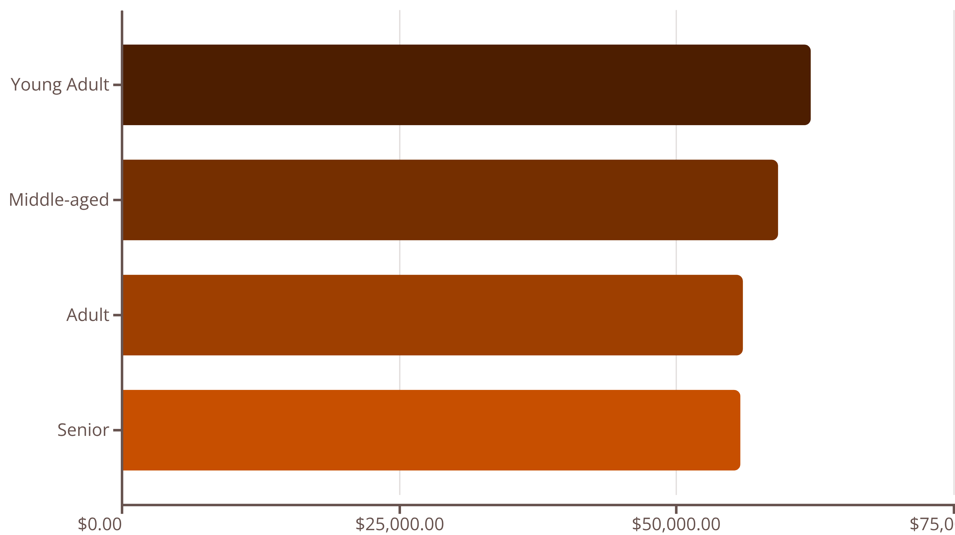
Revenue by Age Group
Young adults lead revenue generation, but all age groups contribute relatively evenly, suggesting broad market appeal with opportunities for age-specific campaigns.

Slide 9
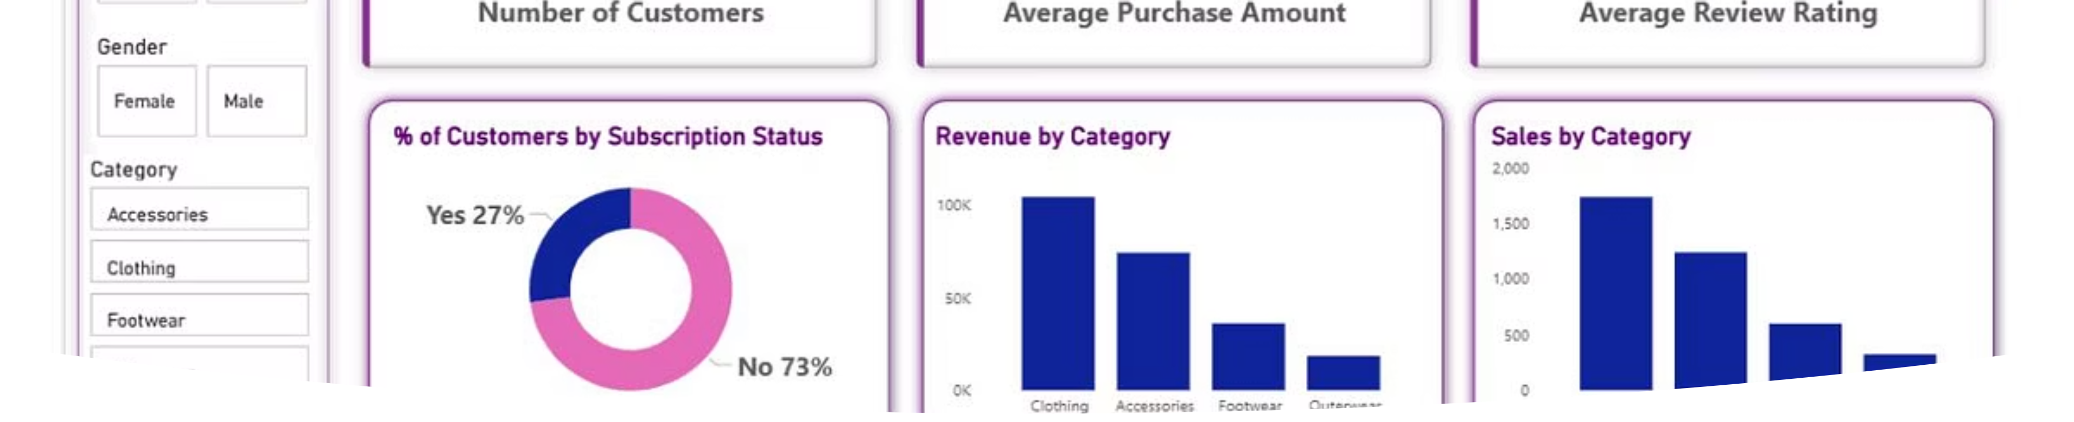
Interactive Dashboard
Comprehensive Power BI dashboard visualizing key metrics including revenue trends, customer segments, product performance, and behavioral patterns for actionable insights.

Slide 10

Strategic Recommendations
Boost Subscriptions
Loyalty Programs
Review Discount Policy
Promote exclusive benefits and perks to increase subscriber value and conversion rates.
Reward repeat buyers to transition them from returning to loyal customer segments.
Balance promotional sales boosts with margin control to optimize profitability.
Product Positioning
Targeted Marketing
Highlight top-rated and best-selling products in marketing campaigns and merchandising.
Focus efforts on high-revenue age groups, male customers, and express-shipping users.

